Slide 1
CAPSTONE PROJECT THE BATTLE OF neighborhoods
Applied Data Science Capstone
IBM Data Science Professional Certificate
- Presented by Harry Li

Slide 2
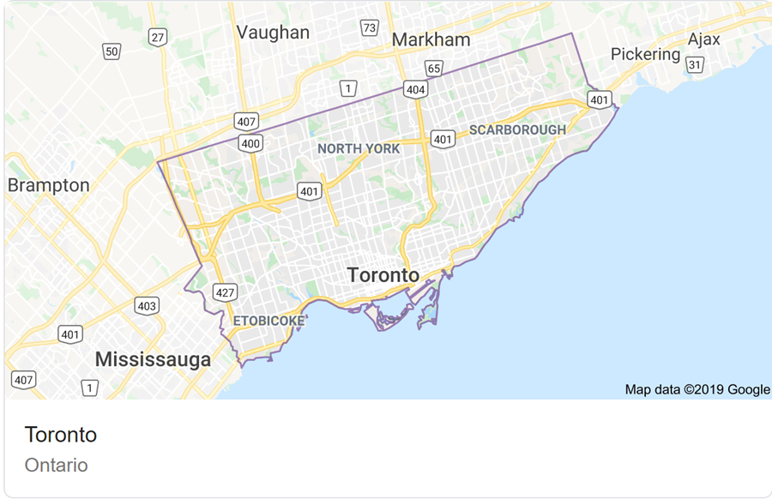
Introduction
In Toronto, getting a spot in daycare for your child can be extremely hard. “Get on a daycare list while you’re pregnant,” is something you hear from everyone when you’re expecting. For popular daycares, getting on the list is not enough as it may take up to a year to eventually fit your child in. The situation of not having enough daycare spots have been aggravated by a recent unexpected “baby boom” in Canada.
Our client Cynthia decides to seize this opportunity and open a daycare business in GTA. Since she lives in Toronto, she will be focusing on potential location in that target area. As a consulting firm, our goal is to help Cynthia find the best location that maximizes the probability of success.

Slide 3
Business problem
Given the large initial investment, a scoring model is rigorously designed. Similar to retail business, the ideal location is featured with “High Demand with Low Competition” for daycare facility. The following factors are considered:
Low Completion: Number of Existing daycare/Preschool facilities
Boroughs with higher number of existing daycare/preschool facilities should be avoided due to higher competition.
High Demand: Number of Elementary School
Boroughs with larger number of Elementary School indicates a higher demand for childcare service.
Safety concerns: 1) Number of Industrial Estate 2) Number of Gas station
Safety is number one priority for daycare facility. An ideal location should be far from industrial estate or busy street intersections (usually where the gas stations are located)

Slide 4
Data
To find the best location for daycare facility, the following sources of information will be leveraged:
Location Data:
Toronto Postal Codes: https://en.wikipedia.org/wiki/List_of_postal_codes_of_Canada:_M
Geo Location (latitude, longitude)
Venues Data From Foursquare: https://developer.foursquare.com/docs/resources/categories
Preschool - 52e81612bcbc57f1066b7a45
Elementary School - 4f4533804b9074f6e4fb0105
Industrial Estate - 56aa371be4b08b9a8d5734d7
Gas station - 4bf58dd8d48988d113951735

Slide 5
Methodology
The postal codes are first imported from Wikipedia. It contains 4 boroughs and 38 neighborhoods. The Geo Location is then retrieved using Geocoder.
Folium is imported and each neighborhood is represented by a blue dot in the map.
For each neighborhood, the information of preschool, elementary schools, industry sites and gas stations are retrieved from Foursquare (venues).
For each neighborhood we group and count each one of the 4 categories
We define weights for each category, depending on the recurrence
Preschool: -10 points
Elementary Schools: 5 point
Industry site: -5 points
Gas station: -5 points
For each neighborhood, we calculate a final score and sort the data by final score in a descending order.
Finally, the place with the highest score will be recommended.

Slide 6
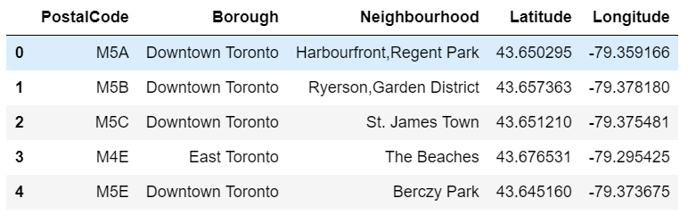
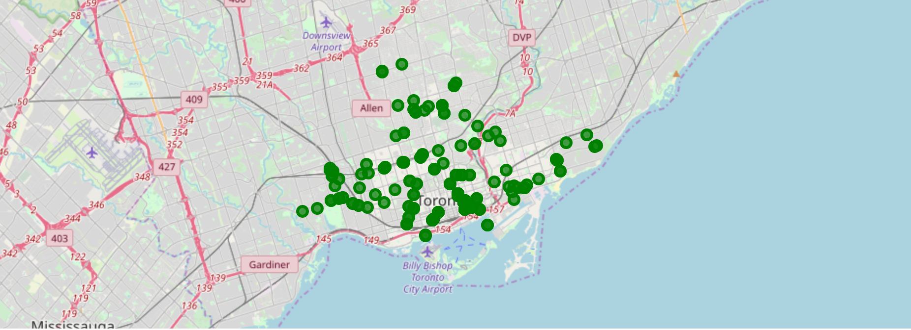
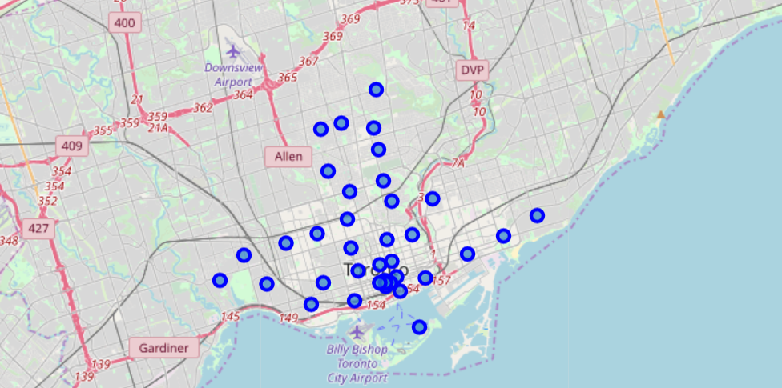
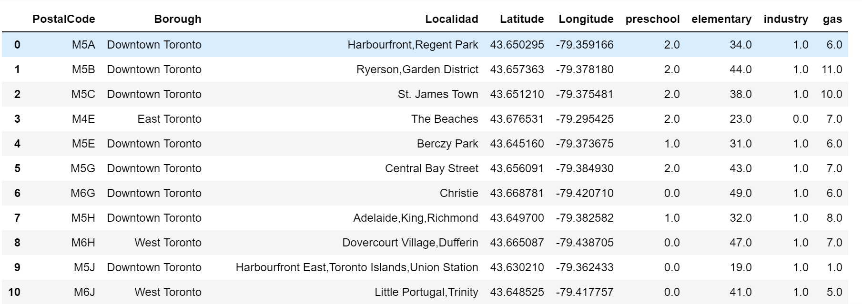
Results

Slide 7
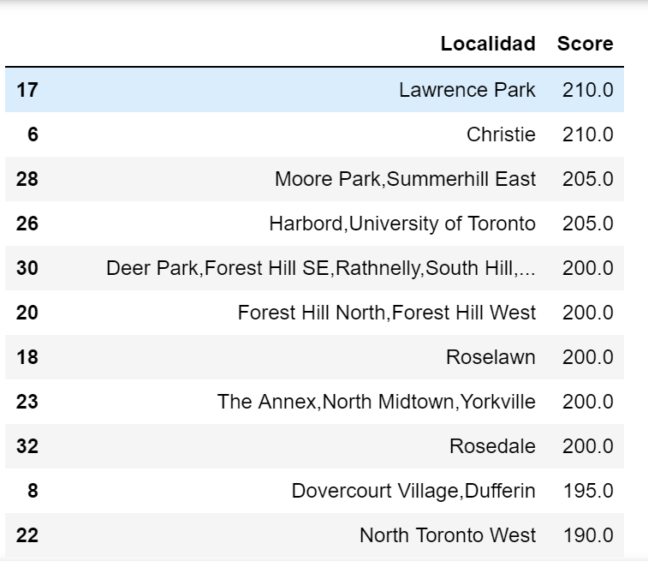
Results - COntinued
We finally apply the weight and score each neighborhood. As shown, the Lawrence Park and Christie are the winners

